Slide 1
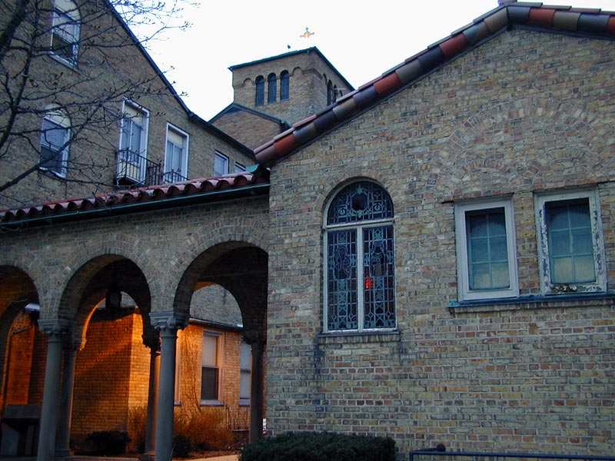

Slide 2

Off To The Hospital
Before you go you should know the reason that prompts you to make the decision to go.
"Why am I going?" Sounds ridiculous. It is not. The motive for your visit measures the value of the visit.
Your reason for visiting will reflect in your attitude to the patient, and in most cases that attitude will be obvious to the patient.

Slide 3
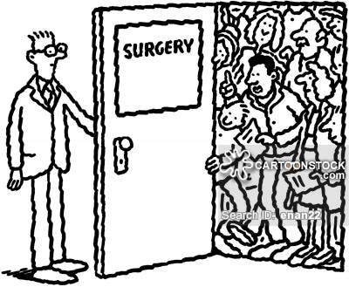
Too Many Visitors
Too many visitors may have an adverse effect on the progress of a patient in the hospital, as well as the nature of the visit.
1. As those who move among patients daily, chaplains and staff frequently hear expressions of relief that a visitor or visitors have at least gone.
2. Patients are sometimes more exhausted and weak on Monday morning after weekend of visitors.
3. There are also the occasion when a patient becomes very depressed following the visit of a pastoral person who speaks inappropriately.

Slide 4

Out of Duty?
As a relative, friend or pastoral care visitor, the reason for going to the hospital springs so often out of sense of obligation. The fulfillment of that sense of duty hopefully will make the patient happy. Is this a trap that we fall into?
1. Are we visiting in order to be released from the guilt of unperformed responsibility?
2. All this has a ring of selfishness about it. It is satisfying our ego.
3. Duty can help fulfill OUR desire to be needed and our sense of being a martyr for the cause.
4. It promotes the concept, which we desire others people to have of us, of always busy doing good.
Doing our job helps maintain the reputation and name we are building for ourselves. The greater the inconvenience, the greater the expected acclaim. The duty visit lacks component of pastoral care: SPIRITUAL SENSITIVITY

Slide 5

To Cheer Up The Patient
It must be remember that persons under treatment in the hospital are not physically well.
Their whole person, body, mind and spirit in most cases, is Affected by the illness or treatment.
This means that they tire easily.
Rest and sleep are two of the greatest components of recuperation the process.

Slide 6


Out Of Curiosity
Hospitals and illness hold an unusual fascination for some people.
They seem to have an obsession with patients symptoms and treatments.
For this reason such people are eager to become hospital visitors.
Such visits have a little value, seldom brings support, comfort, or strength to the patient.
A visit to a patient needs to come with sincerity and with a genuine desire to provide pastoral care.
Curiosity and competition play no part in providing pastoral care in a hospital setting.

